Slide 1
CHAPTER-6
POLITICAL PARTIES

Slide 2
Prepare a collage of the remedial measures taken by any one political party in India.

Slide 3
CONTENT SLIDE

Slide 5
Partisan: A person who is strongly committed to a party.
Partisanship: It is marked by the tendency to take aside and inability to take a balanced view on an issue.

Slide 6
Functions of political parties:
Contest elections:
Put forward different policies and programmes.
They play a decisive role in making laws.
They form and run the government.
Role of opposition;
Shape public opinion.
Access to government machinery and welfare schemes

Slide 7
Questions:
Define a political party.
What are the components of the political party?
2)Explain the functions of the political parties.

Slide 8
Necessity of Political party;
Every candidate will be independent
Promises will not be made
Uncertain government.
Accountable to their locality but not to the country
Villages get split into more than one faction

Slide 10
POLITICAL PARTIES/POLITICAL SCIENCE-GRADE-X/Mrs Sujatha/SOCIAL SCIENCE/ SNS ACADEMY

Slide 14
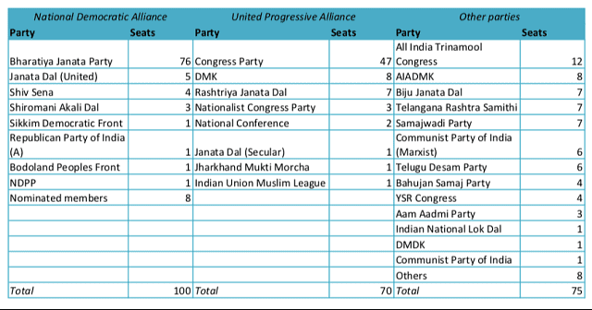

Slide 15
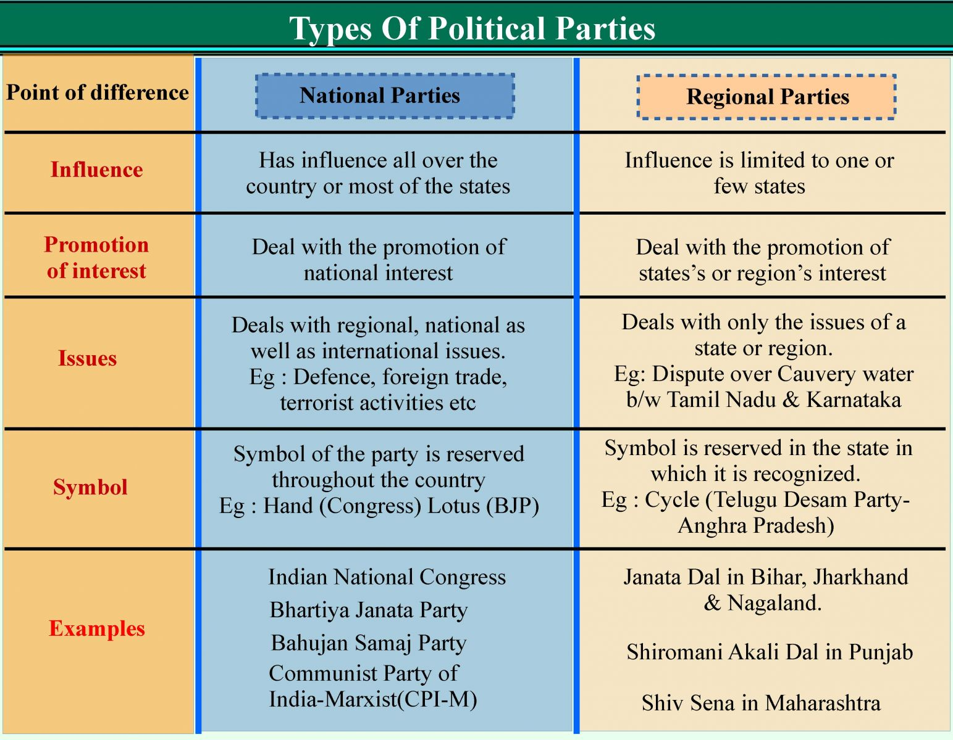
POLITICAL PARTIES/POLITICAL SCIENCE-GRADE-X/Mrs Sujatha/SOCIAL SCIENCE/ SNS ACADEMY

Slide 16
Questions:
Explain party system in india.
2) What is an alliance?
3) Why has India encouraged multiparty system?

Slide 18
POLITICAL PARTIES/POLITICAL SCIENCE-GRADE-X/Mrs Sujatha/SOCIAL SCIENCE/ SNS ACADEMY

Slide 19
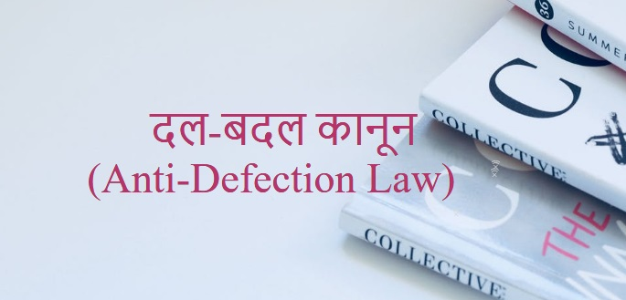
Reforms of political party
Anti defection law:
Affidavit:
Organisational elections:

Slide 20
Suggestions to reform political party.
Law to regulate internal affairs of political party.
Minimum number of tickets to women candidates.
State funding of elections.

Slide 21
Over regulations of reforms can be counterproductive.
Political parties will find ways to cheat laws.
Two other possible ways:
Pressure on political parties
Loss of public support.

Slide 22
QUESTIONS RELATED TO ABOVE SLIDES
1)Mention the reforms of political parties.
2) Highlight a few suggestions to reform political
parties.

Slide 23
REFERENCES:
https://www.youtube.com/watch?v=gp7L-wrMBaI
https://www.youtube.com/watch?v=TumGR91gtyQ
Thank you

